Slide 1

Python

Slide 2
Introduction and Features
1.
Working with python
2.
3.
its execution modes
Agenda
Comments, Variables & Data Types
4.
5.
List, Tuple, Dict., Sets
6.
Data Structures

Slide 3
Introduction
popular programming language
It was created by Guido van Rossum, and released in 1991.
web development (server-side)
software development
mathematics
system scripting
It is used for:

Slide 4
What can Python do?
Python can be used on a server to create web applications.
Python can be used alongside software to create workflows.
Python can connect to database systems. It can also read and modify files.
Python can be used to handle big data and perform complex mathematics.
Python can be used for rapid prototyping, or for production-ready software development.

Slide 5
Why Python?
Python works on different platforms (Windows, Mac, Linux, Raspberry Pi, etc.).
Python has a simple syntax similar to the English language.
Python has syntax that allows developers to write programs with fewer lines than some other programming languages.
Python runs on an interpreter system, meaning that code can be executed as soon as it is written. This means that prototyping can be very quick.
Python can be treated in a
procedural way;
an object-oriented way;
a functional way.

Slide 6
Features of Python Language
Free & open source.
Interpreted Language.
Case-Sensitive Language.
Portable & platform independent.
It has a rich library of predefined functions.
Object Oriented Programming. [Inheritance, Data Abstraction, Encapsulation & Polymorphism]
Indentation instead of braces.
Various sequence types [list, tuple, dictionary, sets]
Exception handling as well as file handling

Slide 7
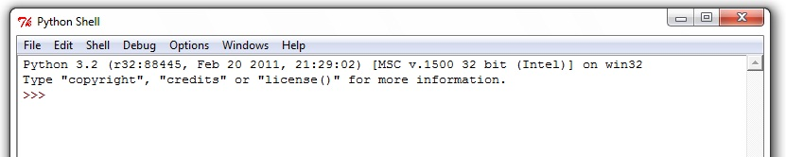
Working With Python
1. To write and run (execute) a Python program, we need to have a Python interpreter installed on our computer
2. The interpreter is also called Python shell
3. The symbol >>> is the Python prompt, which indicates that the interpreter is ready to take instructions.
4. We can type commands or statements on this prompt to execute them using a Python interpreter.

Slide 8
Run
with some input
Write/Edit
OK?
NO
YES
YES
NO
More Inputs?

Slide 9
Execution Modes
Interactive Mode
Interactive mode allows execution of individual statement instantaneously.
Script Mode
Whereas, Script mode allows us to write more than one instruction in a file called Python source code file that can be executed.
Interactive Mode
Script Mode

Slide 10
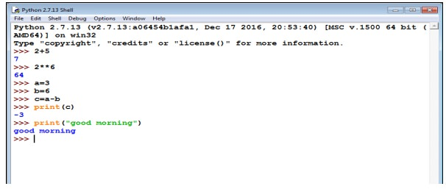
Interactive Mode
Advantages:
Convenient for testing a single line code
Instant execution
Disadvantages:
Can’t be save
Retype the statements to run again.
To work in the interactive mode, we can simply type a Python statement on the >>> prompt directly. As soon as we press enter, the interpreter executes the statement and displays the result(s)

Slide 11
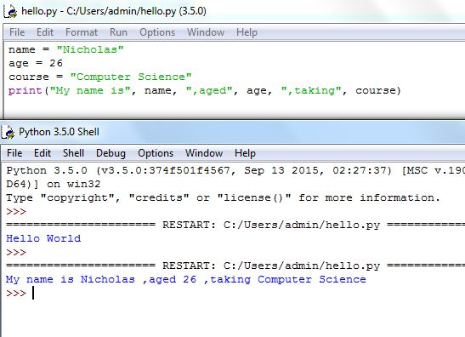
Script Mode
Extension: .py
In the script mode, we can write a Python program in a file, save it and then use the interpreter to execute it.

Slide 12
Comments in Python
Multi-Line
Single-Line
Comments

Slide 13
Single-line Comments
Comment
#This is a comment.
print("Hello, World!")

Slide 14
Comments
Comment
print("Hello, World!") #This is a comment.

Slide 15
Multi Line Comments
Comment
#This is a comment #written in #more than just one line print("Hello, World!")

Slide 16
Multi Line Comments
Comment
""" This is a comment written in more than just one line """ print("Hello, World!")

Slide 17
Python program to add two numbers
num1 = 15
num2 = 12
sum = num1 + num2
print("Sum of {0} and {1} is {2}" .format(num1, num2, sum))

Slide 18
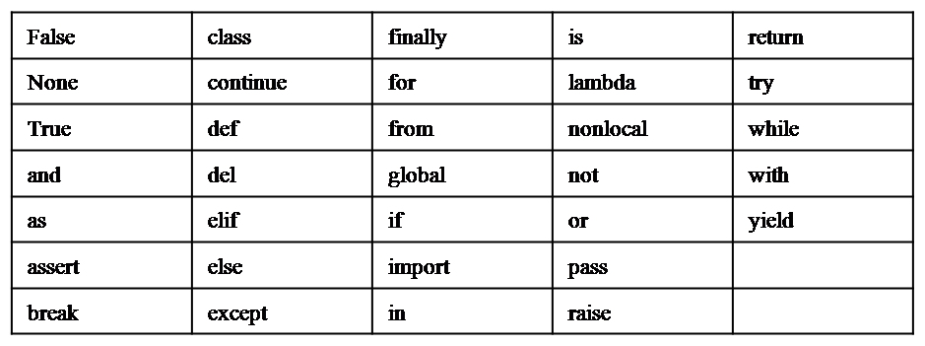
Python Keywords
Keywords are reserved words.
As Python is case sensitive, keywords must be written exactly.

Slide 19
Identifiers
The name should begin with an uppercase or a lowercase alphabet or an underscore sign (_). This may be followed by any combination of characters a–z, A–Z, 0–9 or underscore (_). Thus, an identifier cannot start with a digit.
• It can be of any length. (However, it is preferred to keep it short and meaningful).
• It should not be a keyword or reserved word.
• We cannot use special symbols like !, @, #, $, %, etc., in identifiers.

Slide 20
Variables Declarations
Container that is used to store values.
>>>gender = 'M’
>>>message = "Keep Smiling"
>>>price = 987.9
>>>userNo = 101
>>>print('User Number is', userNo)
>>>length = 10
>>>breadth = 20
>>>area = length * breadth
>>>print(area)

Slide 21
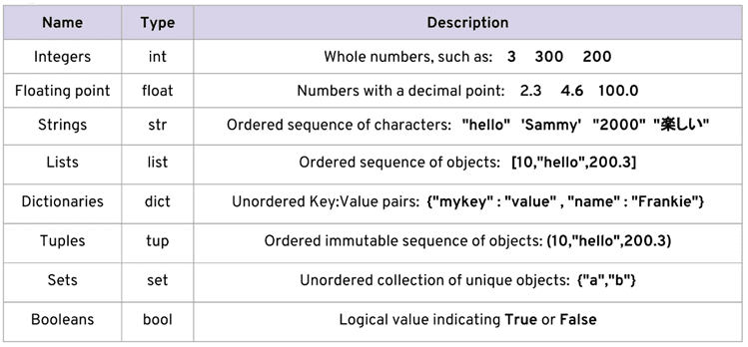
Data Types

Slide 22
To determine the data type of the variable using built-in function type().
Data Types
>>> num1 = 10
>>> type(num1)
>>> num2 = -1210
>>> type(num2)
>>> var1 = True
>>> type(var1)
>>> float1 = -1921.9
>>> type(float1)
>>>var2 = -3+7.2j
>>> type(var2)
<class ‘int’>
<class ‘int’>
<class ‘bool’>
<class ‘float’>
<class ‘complex’>

Slide 23
Sequence
Sets
{ }
String
“ ”
Tuple
( )
List
[ ]
Dictionary
{ }

Slide 24
List
>>> list1 = [2,4,6,8,10,12]
>>> print(list1)
[2, 4, 6, 8, 10, 12]
>>>list3 = [100,23.5,'Hello’]
>>> print(list3)
[100, 23.5, 'Hello’]
Accessing Elements in a List
>>> list1 = [2,4,6,8,10,12]
>>> list1[0] #return first element of list1 2
>>>list1[-1] #return first element from right 12
>>> n = len(list1)
>>> print(n) 6

Slide 25
List
#return the last element of the list1
>>> list1[n-1]
12
#return the first element of list1 >>> list1[-n] 2
>>> n = len(list1)
>>> print(n) 6
2
4
6
8
10
12

Slide 26
List
Lists are Mutable
>>> list1 = ['Red','Green','Blue','Orange'] >>> list1[3] = 'Black’
>>>list1
['Red', 'Green', 'Blue', 'Black']
List Operations: Concatenation
>>> list1 = [1,3,5,7,9]
>>> list2 = [2,4,6,8,10]
>>>list1 + list2
[1, 3, 5, 7, 9, 2, 4, 6, 8, 10]

Slide 27
List
List Operations: Concatenation
>>>List3 = ['Red','Green','Blue’]
>>>list4 = ['Cyan', 'Magenta', 'Yellow' ,'Black’]
>>> list3 + list4 ['Red','Green','Blue','Cyan','Magenta','Yellow','Black']

Slide 28
List
>>>list1 = [1,2,3]
>>> str1 = "abc"
>>> list1 + str1
TypeError: can only concatenate list (not "str") to list
Repetition:
>>>list1 = ['Hello’]
>>> list1 * 4 ['Hello', 'Hello', 'Hello', 'Hello']

Slide 29
List
Membership:
>>> list1 = ['Red','Green','Blue’]
>>> 'Green' in list1
True
>>> 'Cyan' in list1
False
list1 = ['Red','Green','Blue’]
>>> 'Cyan' not in list1 True
>>> 'Green' not in list1
False

Slide 30
List
Slicing:
>>> list1 =['Red','Green','Blue','Cyan','Magenta','Yellow','Black’]
>>> list1[2:6]
['Blue', 'Cyan', 'Magenta', 'Yellow']
Red
Green
Blue
Cyan
Magenta
Yellow
Black

Slide 31
List
Slicing:
>>> list1[2:20] #second index is out of range
['Blue', 'Cyan', 'Magenta', 'Yellow', 'Black']
Red
Green
Blue
Cyan
Magenta
Yellow
Black

Slide 32
List
Slicing:
>>>list1[7:2] #first index > second index []
#results in an empty list

Slide 33
List
Slicing:
>>> list1[:5] #first index missing ['Red','Green','Blue','Cyan','Magenta']
Red
Green
Blue
Cyan
Magenta
Yellow
Black

Slide 34
List
Slicing:
>>> list1[0:6:2]
['Red','Blue','Magenta']
Red
Green
Blue
Cyan
Magenta
Yellow
Black

Slide 35
List
Slicing:
>>> list1[-6:-2]
['Green','Blue','Cyan','Magenta']
Red
Green
Blue
Cyan
Magenta
Yellow
Black

Slide 36
List
Slicing:
list1[::2] #step size 2 on entire list ['Red','Blue','Magenta','Black']
Red
Green
Blue
Cyan
Magenta
Yellow
Black

Slide 37
List
Slicing:
>>> list1[::-1]
['Black','Yellow','Magenta','Cyan','Blue', 'Green','Red']
Red
Green
Blue
Cyan
Magenta
Yellow
Black

Slide 38
Traversing a List
>>> list1 = ['Red','Green','Blue','Yellow', 'Black’]
>>> for item in list1:
print(item)
Red
Green
Blue
Yellow
Black

Slide 39
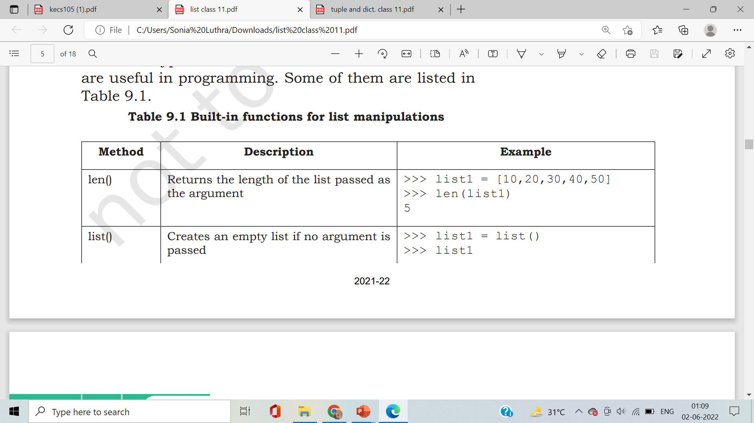
List Methods and Built-in Functions

Slide 40
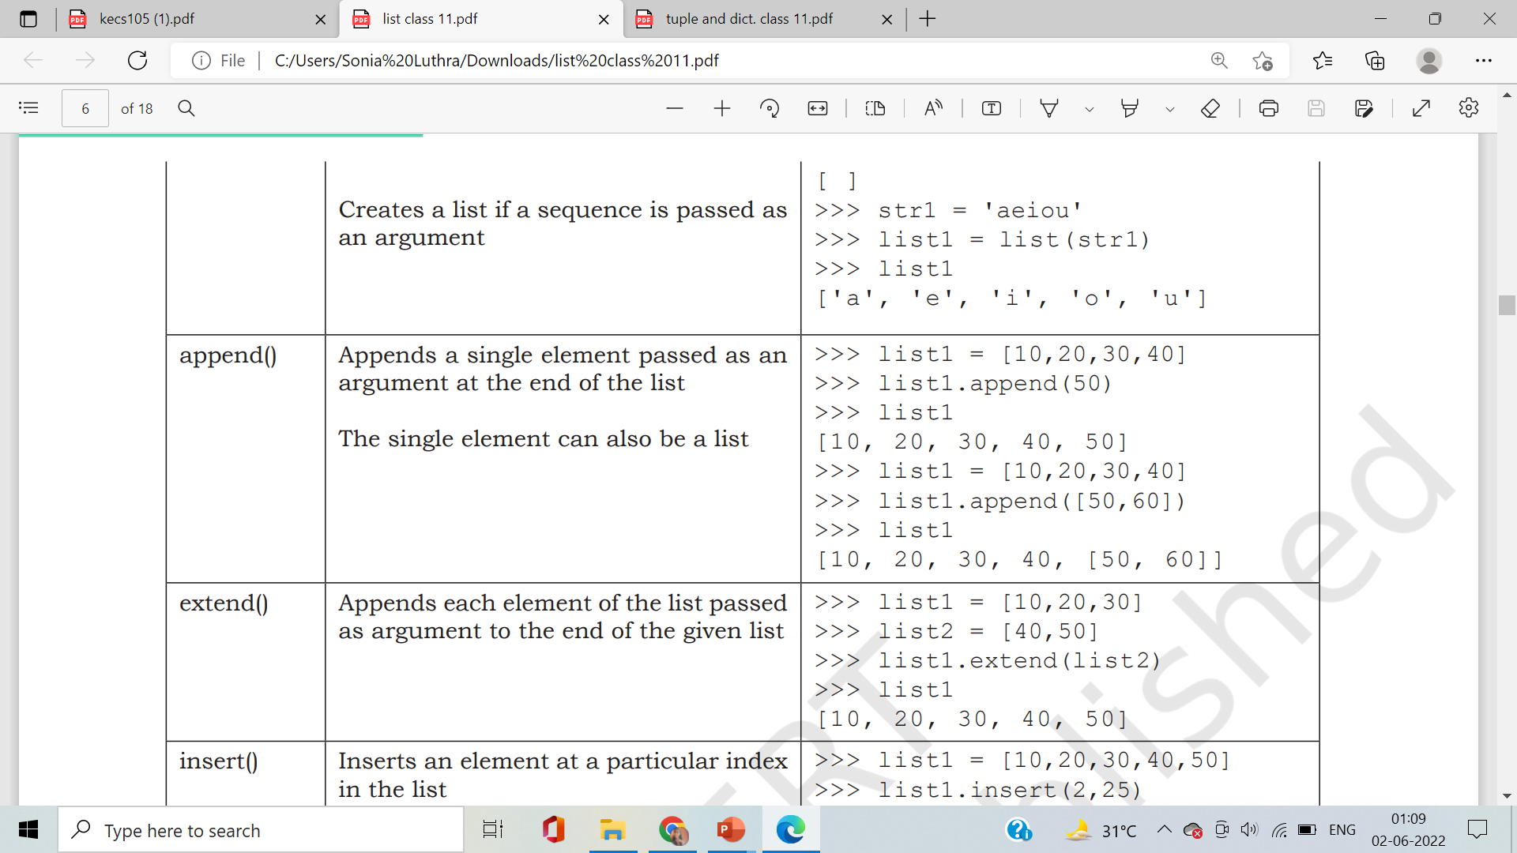
List Methods and Built-in Functions

Slide 41
List Methods and Built-in Functions

Slide 42
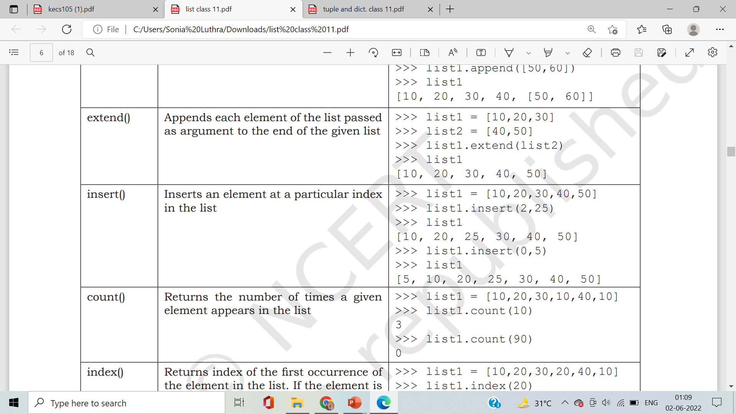
List Methods and Built-in Functions

Slide 43
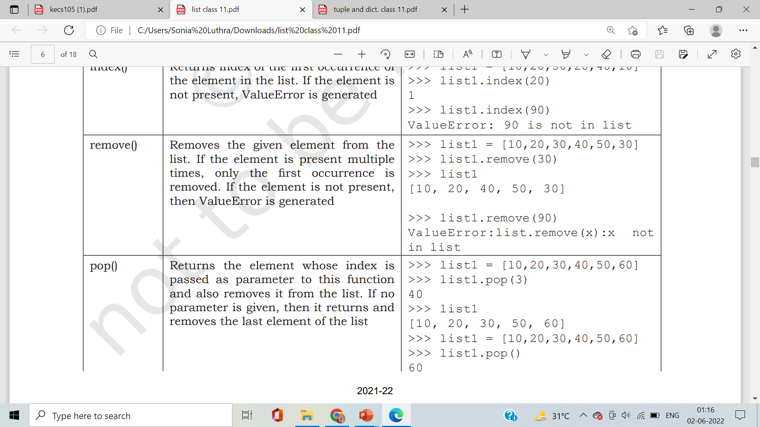
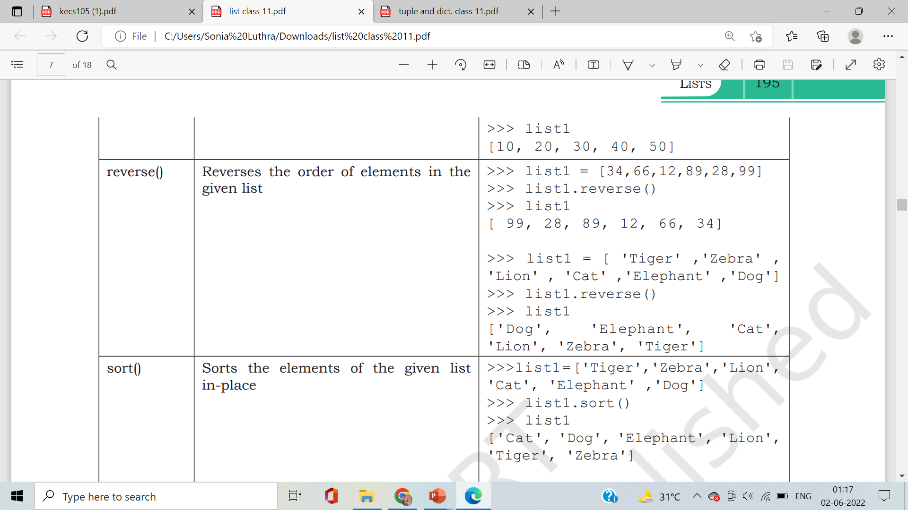
List Methods and Built-in Functions

Slide 44
List Methods and Built-in Functions

Slide 45
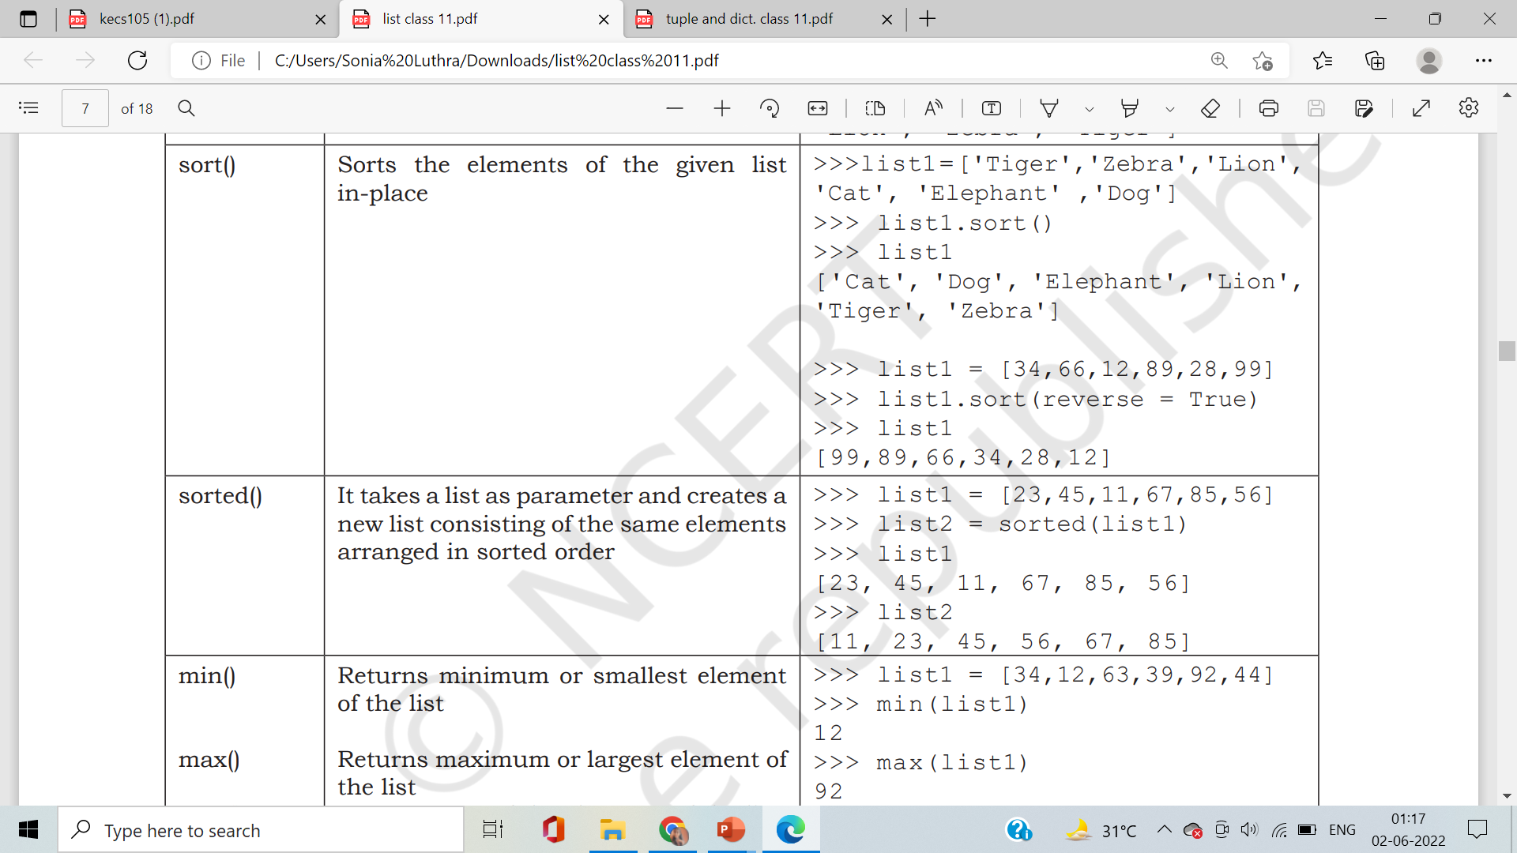
List Methods and Built-in Functions

Slide 46
Sets
myset = {"apple", "banana", "cherry"}
Sets are used to store multiple items in a single variable.
Set is one of 4 built-in data types in Python used to store collections of data.
A set is a collection which is unordered, unchangeable*, and unindexed
Set items are unchangeable, but you can remove items and add new items.
Sets are written with curly brackets.

Slide 47
Sets
Example:
>>>set1 = {"apple", "banana", "cherry"}
>>>print(set1)
# Note: the set list is unordered, meaning: the items will appear in a random order.
# Refresh this page to see the change in the result.
#Sets are unordered, so you cannot be sure in which order the items will appear.

Slide 48
Sets
Duplicates Not Allowed
Example:
>>>set1 = {"apple", "banana", "cherry", "apple"}
>>>print(set1)
Output:
{'banana', 'cherry', 'apple'}

Slide 49
Sets
Get the Length of a Set
Example:
>>>set1 = {"apple", "banana", "cherry"}
>>>print(len(set1))
Output:
3

Slide 50
Sets
Any type of data Type
set1 = {"apple", "banana", "cherry"}
set2 = {1, 5, 7, 9, 3}
set3 = {True, False, False}
set4 = {"abc", 34, True, 40, "male"}
print(set1) Output:
print(set2)
print(set3)
print(set4)
{'cherry', 'apple', 'banana’}
{1, 3, 5, 7, 9}
{False, True}
{"abc", 34, True, 40, "male"}

Slide 51
Sets
type()
Example:
>>>set1 = {"apple", "banana", "cherry"}
>>>print(type(set1))
Output:
<class 'set’>
#From Python's perspective, sets are defined
as objects with the data type 'set':

Slide 52
Sets
The set() Constructor
It is also possible to use the set() constructor to make a set.
set = set(("apple", "banana", "cherry"))
print(set)
Output → {'banana', 'cherry', 'apple'}
# Note: the set list is unordered, so the result will display the items in a random order.

Slide 53
Sets
Access Items
We cannot access items in a set by referring to an index or a key.
But you can loop through the set items using a for loop, or ask if a specified value is present in a set, by using the in keyword.
set = {"apple", "banana", "cherry"}
for x in set:
print(x)

Slide 54
Sets
Add Items
Once a set is created, you cannot change its items, but you can add new items.
>>>set = {"apple", "banana", "cherry"}
>>>set.add("orange")
>>> print(set)

Slide 55
Sets
Add Sets
Once a set is created, you cannot change its items, but you can add new items.
>>>set1 = {"apple", "banana", "cherry"}
>>> set2 = {"pineapple", "mango", "papaya"}
>>> set1.update(set2)
>>> print(set1)

Slide 56
Sets
Add anything to Sets
You can add any list or tuple also.
>>>set1 = {"apple", "banana", "cherry"}
>>> set2 = {"pineapple", "mango", "papaya"}
>>> set1.update(set2)
>>> print(thisset)

Slide 57
Sets
Remove(), discard(), pop(), clear(), del
pop() method removes an element from the end
>>>set1 = {"apple", "banana", "cherry"}
>>> set1.remove(“cherry”)
>>> print(set1)

Slide 58
Sets
Join Sets
Both union() & update() will execute duplicate items.
set1 = {"a", "b" , "c"}
set2 = {1, 2, 3}
set3 = set1.union(set2)
print(set3)

Slide 59
Dictionary
The data type dictionary fall under mapping.
It is a mapping between a set of keys and a set of values.
The key-value pair is called an item.
A key is separated from its value by a colon(:) and consecutive items are separated by commas.
Items in dictionaries are unordered, so we may not get back the data in the same order in which we had entered the data initially in the dictionary

Slide 60
Dictionary
Creating a Dictionary:
>>> dict1 = {}
>>> dict1
{}
>>> dict3 = {'Mohan':95,'Ram':89,'Suhel':92, 'Sangeeta':85} >>> dict3
{'Mohan': 95, 'Ram': 89, 'Suhel': 92, 'Sangeeta': 85}

Slide 61
Dictionary
Accessing Items in a Dictionary:
>>> dict3 = {'Mohan':95,'Ram':89,'Suhel':92, 'Sangeeta':85} >>> dict3['Ram’]
89
>>> dict3['Shyam’]
KeyError: 'Shyam’
Dictionaries are Mutable:
>>>dict1['Meena'] = 78
{'Mohan': 95, 'Ram': 89, 'Suhel': 92, 'Sangeeta': 85, 'Meena': 78}

Slide 62
Dictionary
Modifying an Existing Item
>>> dict3 = {'Mohan':95,'Ram':89,'Suhel':92, 'Sangeeta':85} >>> dict1['Suhel'] = 93.5
>>> dict1 {'Mohan': 95, 'Ram': 89, 'Suhel': 93.5, 'Sangeeta': 85}
Membership Operators: in/not in
>>> ‘Mohan' in dict1
True
>>> ‘Mohan' not in dict1
False

Slide 63
Dictionary
Traversing a Dictionary
>>> for key,value in dict1.items():
>>>print(key,':',value)
Mohan: 95
Ram: 89
Suhel: 92
Sangeeta: 85

Slide 64
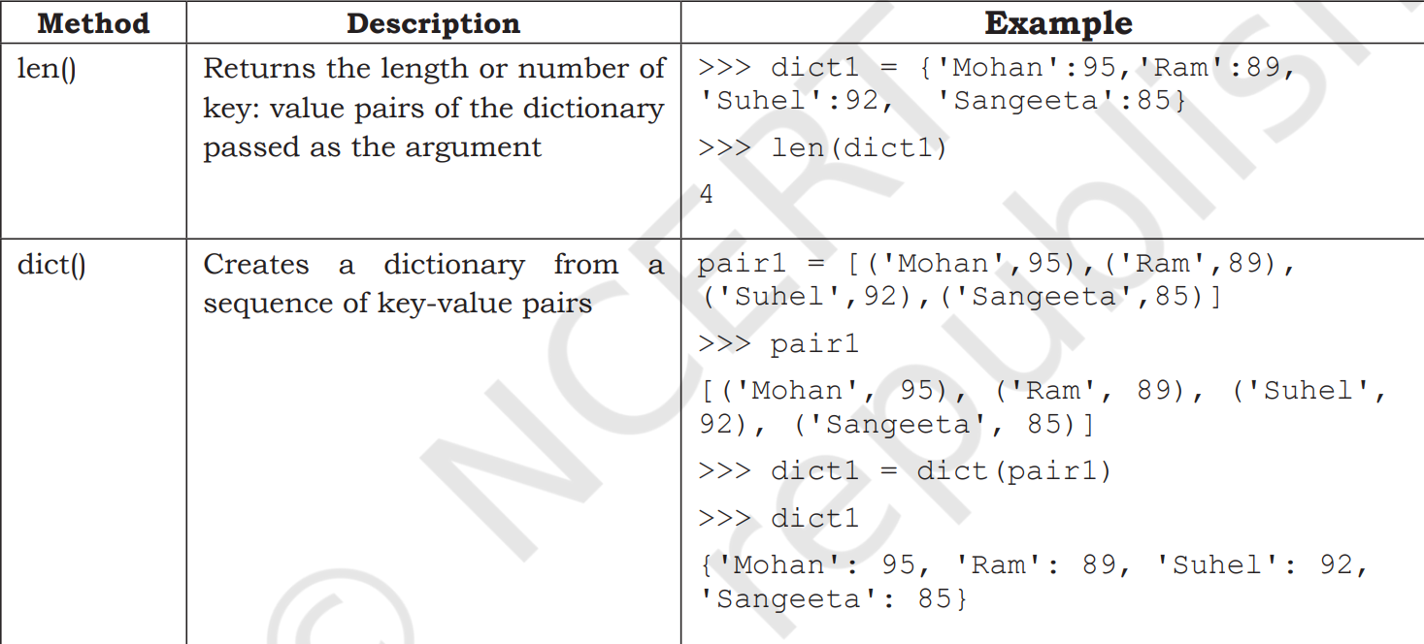
Dictionary methods and Built-in functions

Slide 65
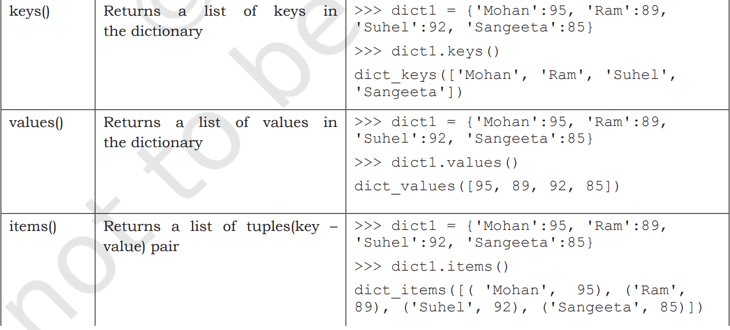
Dictionary methods and Built-in functions

Slide 66
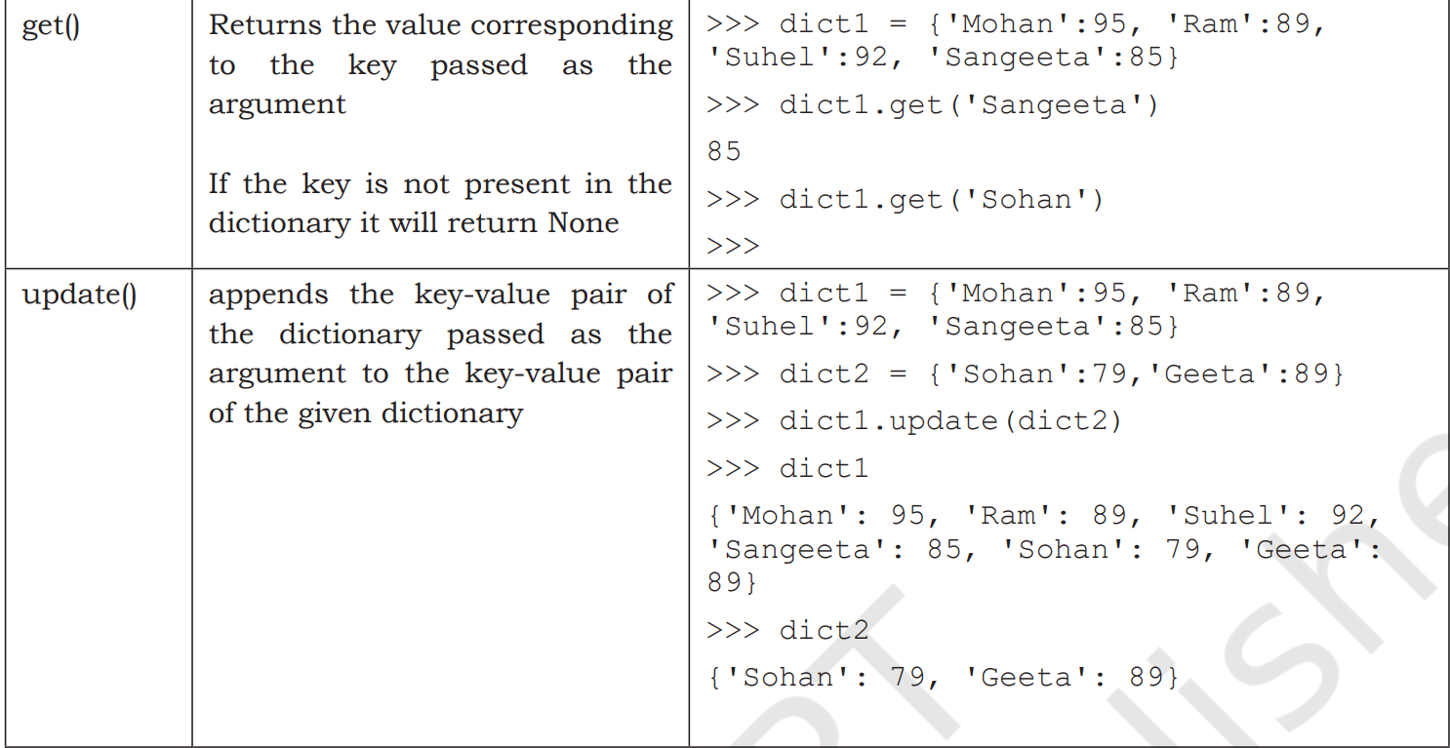
Dictionary methods and Built-in functions

Slide 67
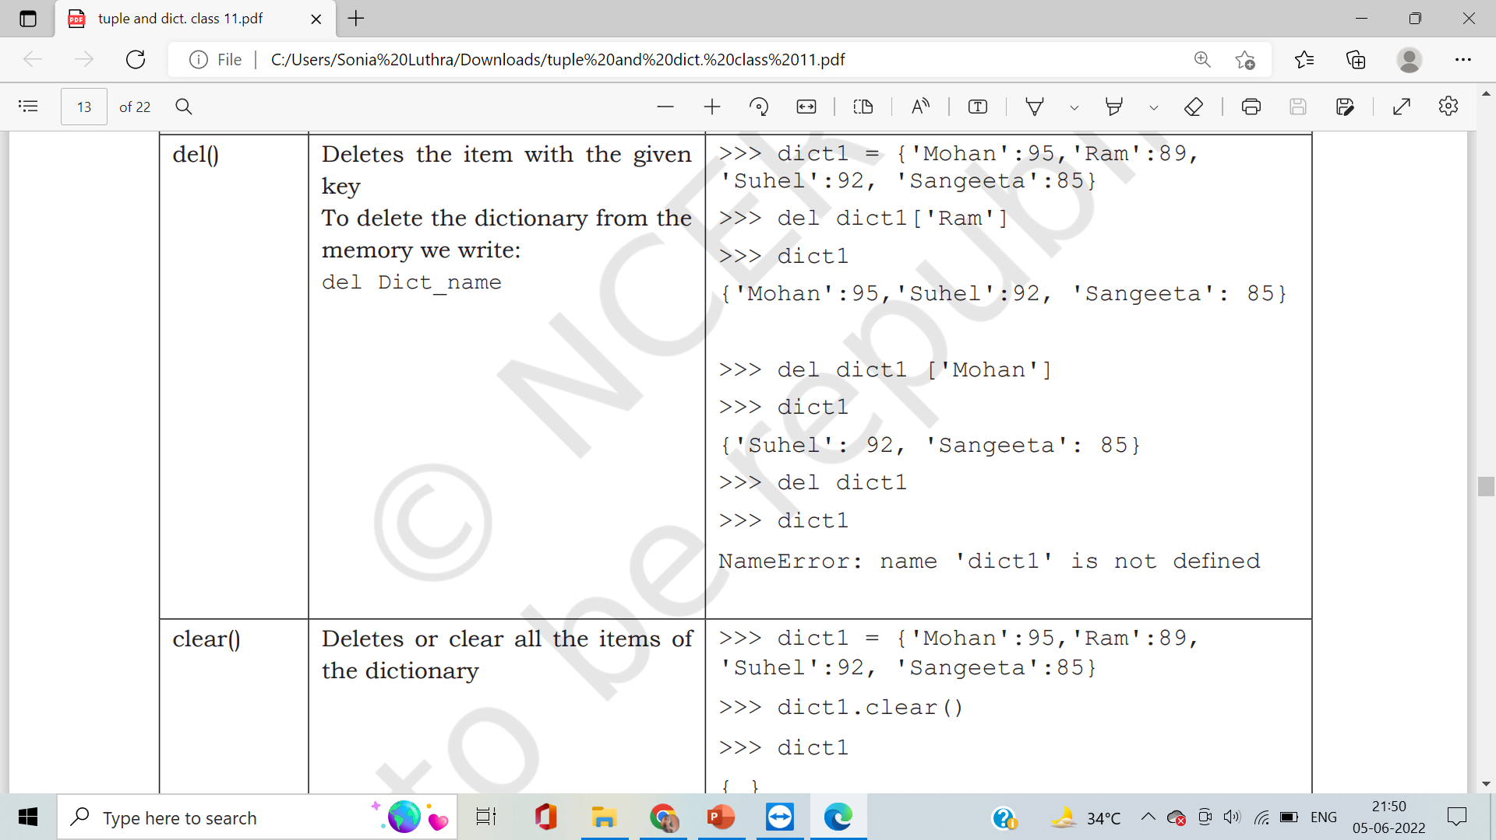
Dictionary methods and Built-in functions

Slide 68
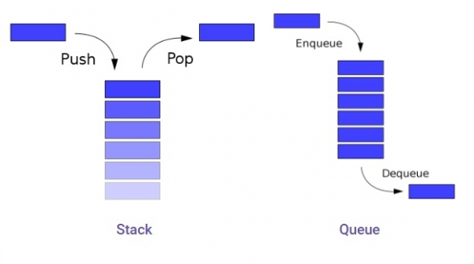
Data Structures in Python
Data structures are a way of organizing and storing data so that they can be accessed and worked with efficiently
Stack [LIFO]
Queue [FIFO]

Slide 69
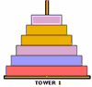
Using Lists as Stacks
The last element added is the first element retrieved
To add an item to the stack, append() must be used
stack = [3, 4, 5]
stack.append(6)
Stack is now [3, 4, 5, 6]
To retrieve an item from the top of the stack, pop must be used
Stack.pop()
6 is output
Stack is now [3, 4, 5] again

Slide 70
#implementation of List as stack
s=[]
c="y“
while (c=="y"):
print("1. PUSH")
print("2. POP")
print("3. Display")
choice=int(input("enter your choice: "))
if (choice==1):
a=input("Enter any number :")
s.append(a)
elif (choice==2):
if (s==[]):
print("stack empty")
else:
print("Deleted element is : ",s.pop())
elif(choice==3):
l=len(s)
for i in range(l-1,-1,-1):
print (s[i])
else:
print("Wrong input")
c=input("Do you want to continue or not? ")

Slide 71
#implementation of List as Queue
s=[]
c="y“
while (c=="y"):
print("1. PUSH")
print("2. POP")
print("3. Display")
choice=int(input("enter your choice: "))
if (choice==1):
a=input("Enter any number :")
s.append(a)
elif (choice==2):
if (s==[]):
print("stack empty")
else:
print("Deleted element is : ",s.pop())
elif(choice==3):
l=len(s)
for i in range(0,1):
print (s[i])
else:
print("Wrong input")
c=input("Do you want to continue or not? ")

Slide 72


